Slide 1

10 Good Habits for Developers
Notes:
Welcome
These are my opinions
Do not reflex the option of my employer, wife, kids or dogs

Slide 2
Habits
Habit: “an acquired behavior pattern regularly followed until it has become almost involuntary”.
It is easy to get caught up in deadlines, technology, product releases etc.
Having good habits will make your life more fun and enjoyable.
Power of Habit - by Charles Duhigg, Mike Chamberlain
Atomic Habits – James Clear
Notes:
https://charlesduhigg.com/the-power-of-habit/
https://www.amazon.com/s?k=power+of+habit&ref=nb_sb_noss_2
What is a habit
Good resources

Slide 3

Take Breaks
Frequent
Go outside
Get fresh Air
Notes:
You need to take frequent breaks, at least 5 minutes every hour or so.
Some developers use a pomodoro timer or type of system.
You need to get up from your chair and walk around. Go outside, get fresh air.
When you are stuck on a problem, is the best time to take a break.
You will be surprised how quickly you resolve the issues after your break.

Slide 4

Ask for help
Hard Habit
Learning Opportunity
Not asking wastes time and adds to your frustration
Notes:
This is a hard habit for many developers to do.
Developers by nature want to solve problems, asking others seems to go against that.
There is the imposture syndrome as well.
Our career field is huge and constantly changing. No can be expected to know of remember everything.
Change the way you think about asking for help. Instead look at it as a learning opportunity.
You need to remember that not asking for help is a waste of your time.
It is good to work a problem as much as you can, but we all have hit that virtual wall. You need to be able to recognize

Slide 5

Never stop learning
Side projects
Volunteer for new work projects
Do volunteer charity development work
Blog
You tube channel
Business programs
Management programs
Notes:
For our profession, this is not only a habit to have, but a necessary to be employable.
Things are always changing. You need to find ways to keep learning.
It would be nice if worked paid and allow you to learn all kinds of new things, but that is rarely the case.
You must know that YOU are the only one responsible for your career. Other can help, but it is all up to you.
There are plenty of ways to achieve this.
Volunteer for new work projects
Side projects
Do volunteer charity development work
Blog
You tube channel
Business programs
Management programs
Everyone learns differently, reading, doing, videos etc. Find how you learn best and find instructors that you can relates to.
Pick things you are interested in and not just technology.

Slide 6

Clean code
Visibly clear code
Effective code
Secure code
Notes:
It is like keep a clean house or maintenance on your car. It will save time and frustration in the future. Best reference the book “Clean Code” https://www.bookgee.com/clean-code-a-handbook-of-agile-software-craftsmanship-1st-MTRwZWFyc29u-pdf-ebookMTRCb29rR2VlLmNvbQ?msclkid=80443649be25163211bd68ba7d9706fc by Robert Martin
Try to achieve:
Visibly clear code
Effective code
Secure code
This sounds a little self-serving but in the long run it will help you. For example, have you ever come back to a project you worked 6 months ago and could not remember what you wrote or why? This habit will make your life easier.

Slide 7

Work life balance
Do not over work
Family/Friends time
Take vacations
Notes:
This habit is good common sense,
do not over work,
spend time with your family
take vacations.
It is easier said than done.
It takes a conscience effort to stop working, get up from your desk and leave when you have a deadline, people counting on you or you are in the middle of a problem. But it will help.
You need to do things other than coding and do things that make you happy.

Slide 8

Avoid Office Politics
Be respectful and diplomatic
Avoid negativity
When you run into a bad situation, ask your self what you can learn from it.
Try the “yes, but” when you hit a conflict.

Slide 9
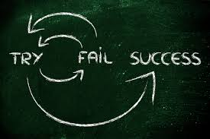
Learn from your mistakes
We all make mistakes
If you are not making mistakes, you are not pushing your self hard enough
Just don’t make the same mistake repeatedly
Notes:
We all make mistakes, that is part of learning.
If you feel you do not make mistakes, then you are not pushing yourself.
You need to learn from your mistakes and avoid making the same mistake multiple times.

Slide 10
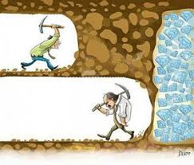
Avoid giving up
Frustration is common
You will learn through the frustration
“Success is just around the corner”
Notes:
Frustration is very common with development.
You cannot give up on the first issue.
You must keep going.
You will learn by these frustrations.
We all have heard the saying “Success is just around the corner”.
There is a balance between not giving up and asking for help to soon or too often.
You will learn the tipping points for these.
It will come with experience.

Slide 11
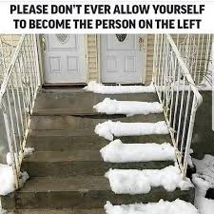
Avoid being “that Person”
We all know one
Be respectful
Do not talk down to others
Be helpful
Treat people how you would like to be treated
Notes:
We all have seen and know the “that person”,
hard to work with,
a know it all,
more willing to tell you it wont work as opposed to helping you getting it to work.
Simply do not be that person.
If you cant think of any that is “that person” it might be you!
Try to :
Be respectful
Do not talk down to others
Be helpful
Treat people how you like to be treated.

Slide 12

Accept criticism
Makes you better
“Yes, Thank you”
Avoid being defensive
Notes:
1. You need to understand that criticism makes you better when you can accept it and learn from it.
2. Try to say “Yes, Thank you”.
3. It is very easy and a natural reaction to get defensive when someone criticizes you.
4. Take a mental time out, relax, breath then answer.

Slide 13

Bonus
Decide each morning that you will have a good day
Notes:
Not to get to philosophical, but you can only control your own thoughts and feelings.
Each morning you get to decide what your attitude will be for the day.
You can choose to be positive and happy, grumpy, and negative or
worst yet, you do not think about it and let others or even “That Person” influence your thoughts and feelings.

Slide 14
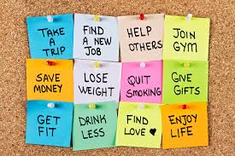
Summary
Notes:
Only you can control you
Good habits help you grow
Again, only my opinion, I suggest you make your list and get started today!
It is well worth the reward.

